Slide 1
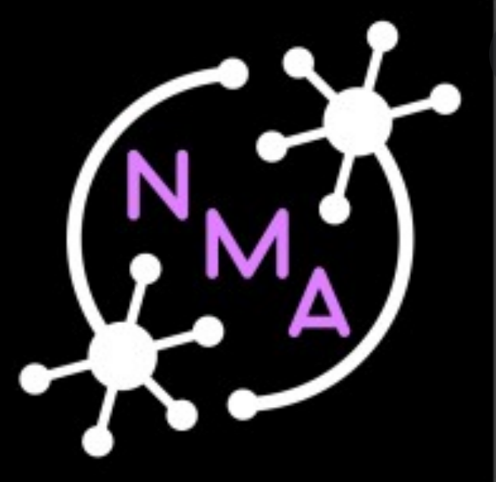
How rewarding can sorting cards be?
Depends on how flexible you are
Foxy Reinforcers 🥵🦊

Slide 2
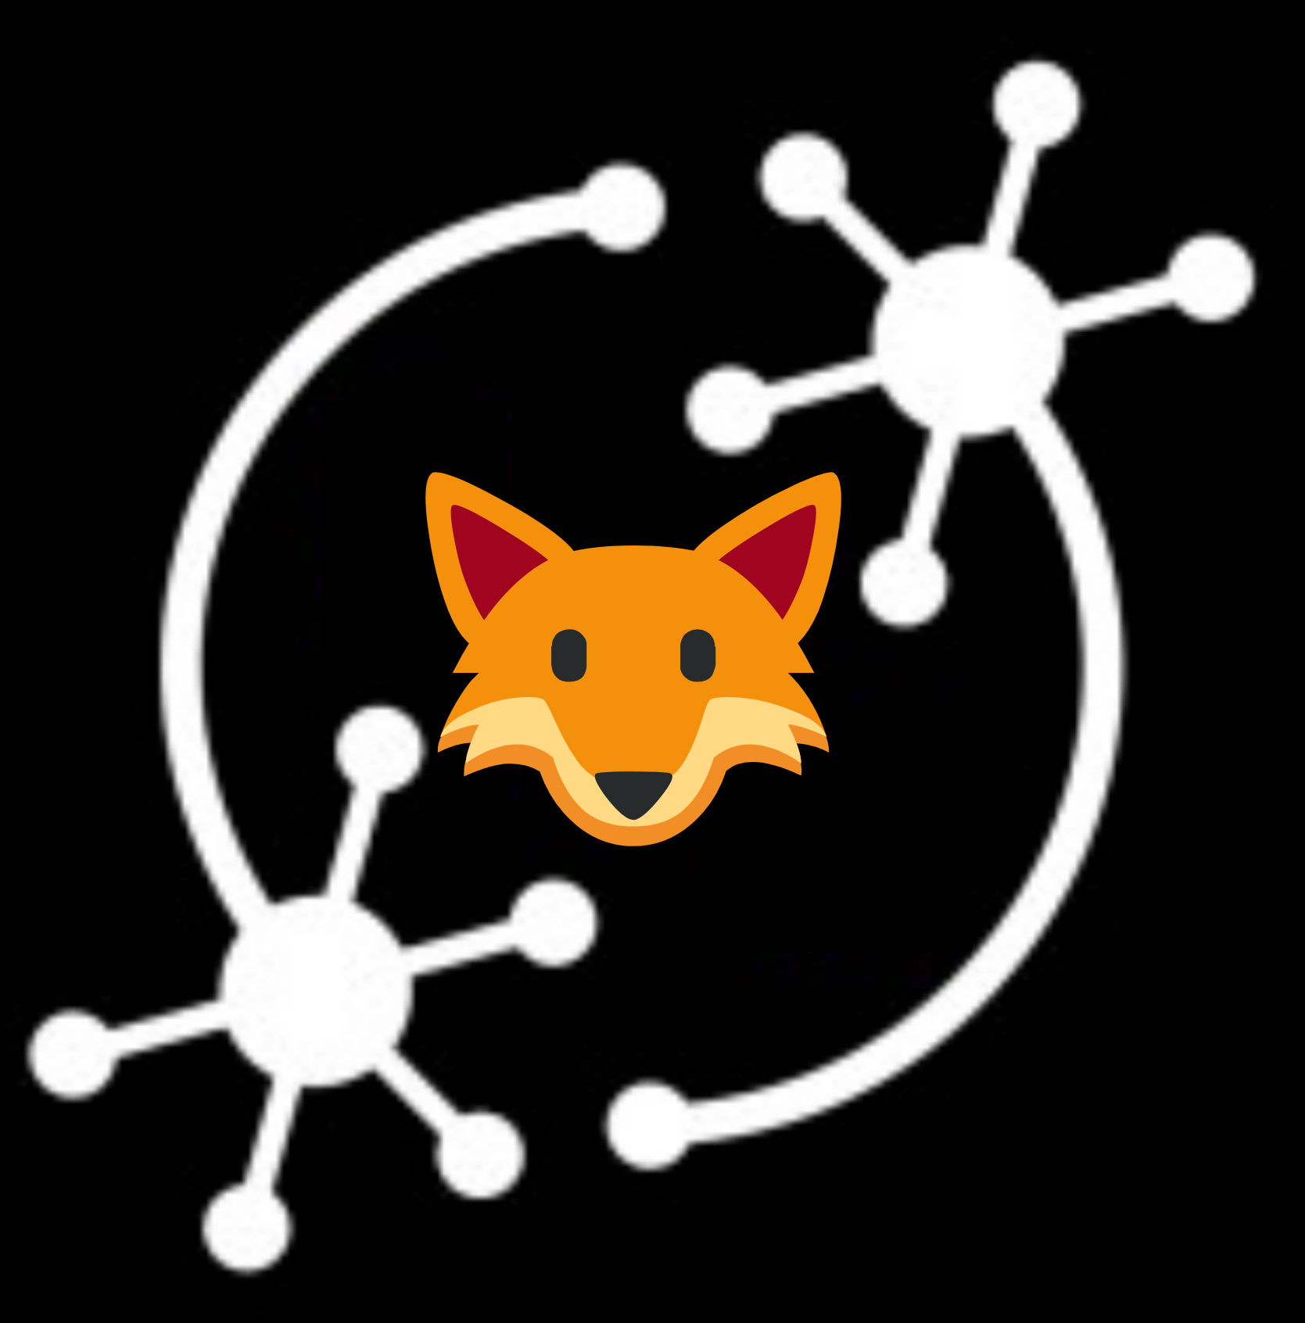
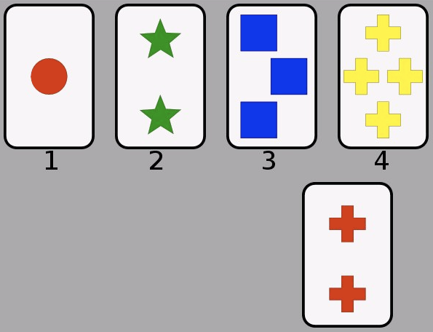
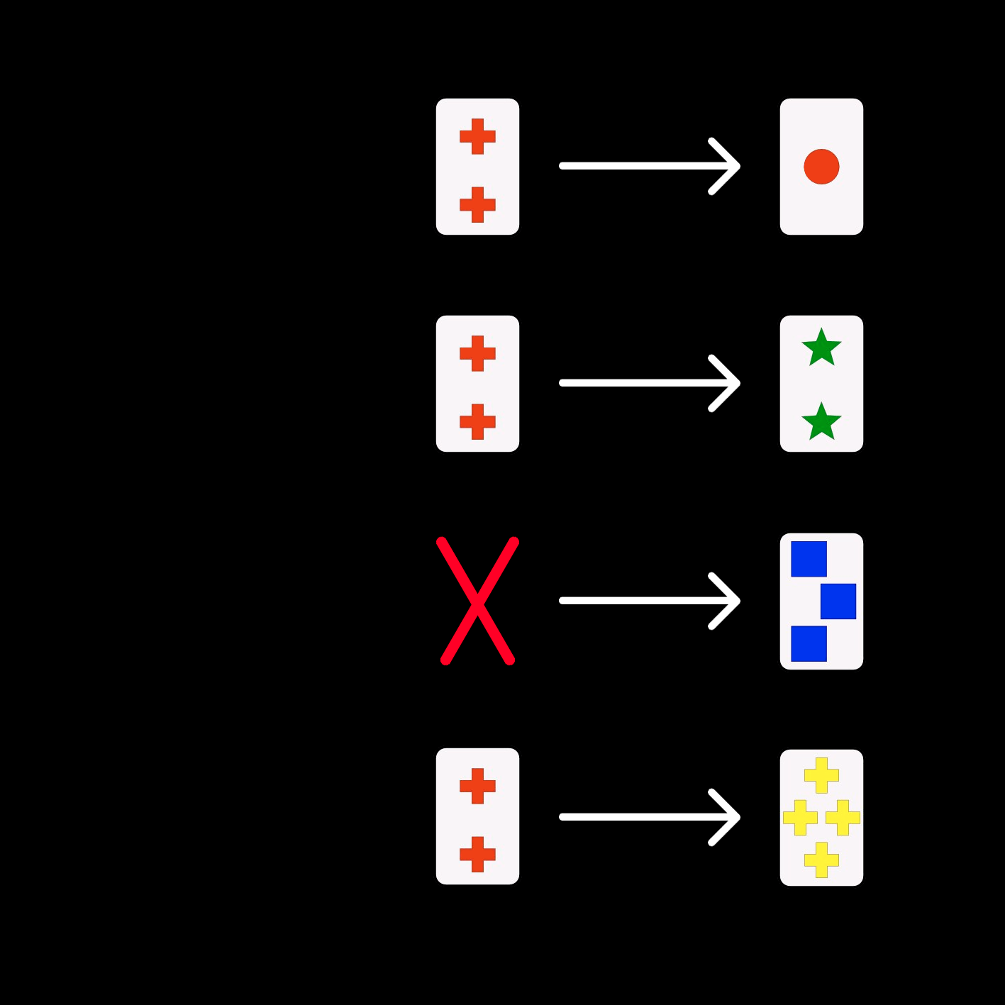
Introduction
Wisconsin Card Sorting Test (WCST)
Cognitive flexibility
Perseveration error + Set-loss errors
Switch
————
Repeat
Question
Will a RL agent make errors similarly to healthy humans performing the WCST?
Color
Number
Shape
Hypothesis
Deep Q-Networks (DQN) will approximate the error distribution of human participants (Steinke et al. 2020) more closely than Naive Q-learning.
Notes:
The Wisconsin Card Sorting Test (WCST) is a way to assess cognitive flexibility in human participants.
On every trial, a card is shown that has to be matched to one of the four key cards according to either colour, shape, or number of elements on the card. Three of the key cards match the card along one of the dimensions each, while the fourth card does not match at all—it is the odd one. The matching rule is drawn randomly and changes after several successful trials.
The participant receives feedback about whether they should apply the same rule as on the last trial, or switch to a different rule. Common errors observed in people who are doing this task are not switching to a new rule after receiving “switch” feedback, and switching to a new rule after receiving “repeat” feedback. We were interested in whether an RL agent will display a behaviour similar to that of human participants. Our hypothesis was that Q-learning algorithms will be able to approximate the conditional error distribution observed in humans. We expected that a Deep Q-network would produce the best fit to experimental data.
Perseveration errors: Erroneous category repetitions following negative feedback
Set-loss errors: Erroneous category switches following positive feedback

Slide 3
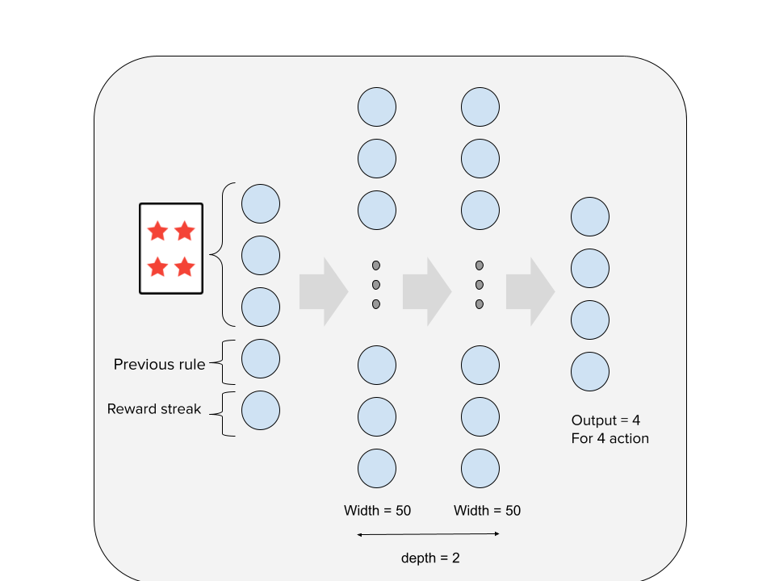
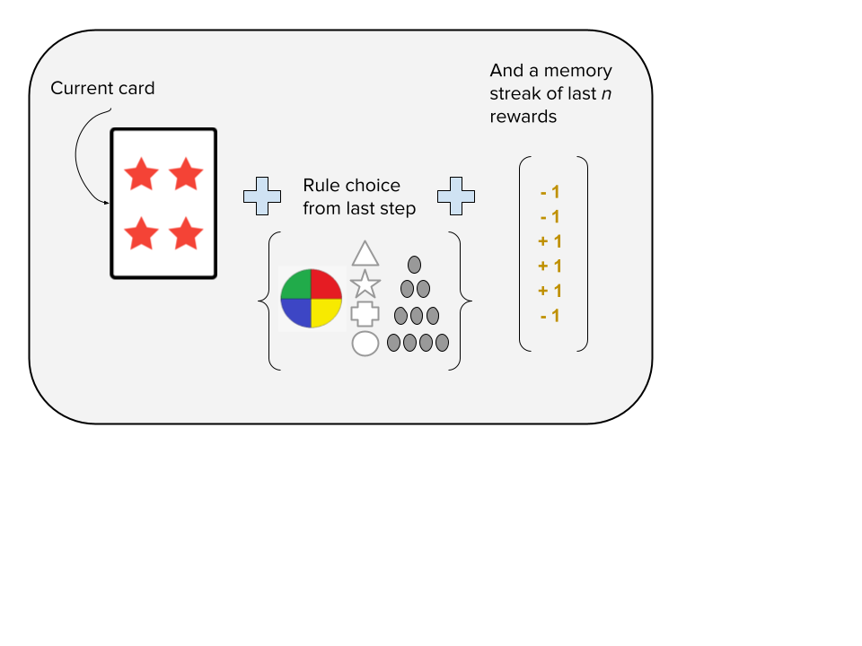
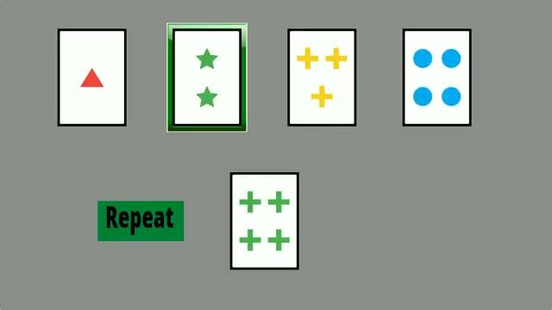
Modeling
Gym Environment
Discrete actions & observations
Sorting rule picked at random
Rule changes after 2-10 correct moves by the player ( geometric distribution, mean 3.5)
Reward of 1 (REPEAT) or -1 (SWITCH)
Vanilla Q-learning Agent
Value based, off-policy, model free
Behavior policy: ϵ-greedy
Learning policy: TD Error min
Short-term memory
Q-table - (24 X 3 X 2n) X 4
Deep Q Network
func(s -> a) approximation.
nn.Linear, nn.Relu
2 hidden layers
batch size 10

Slide 4
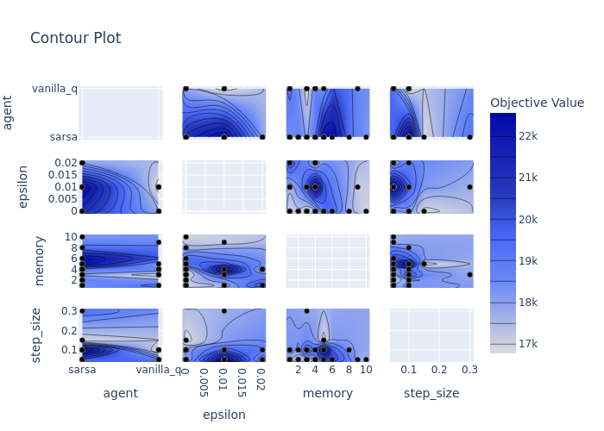
Model fitting, Architecture, Fine tuning
NN architectures we tried
5 → 50 → 50 → 4
5 → (32*n)*k → 4
Best performance
5 → 64 → 96 → 32 → 4
epsilon = 0.01, LR = 0.002

Slide 5
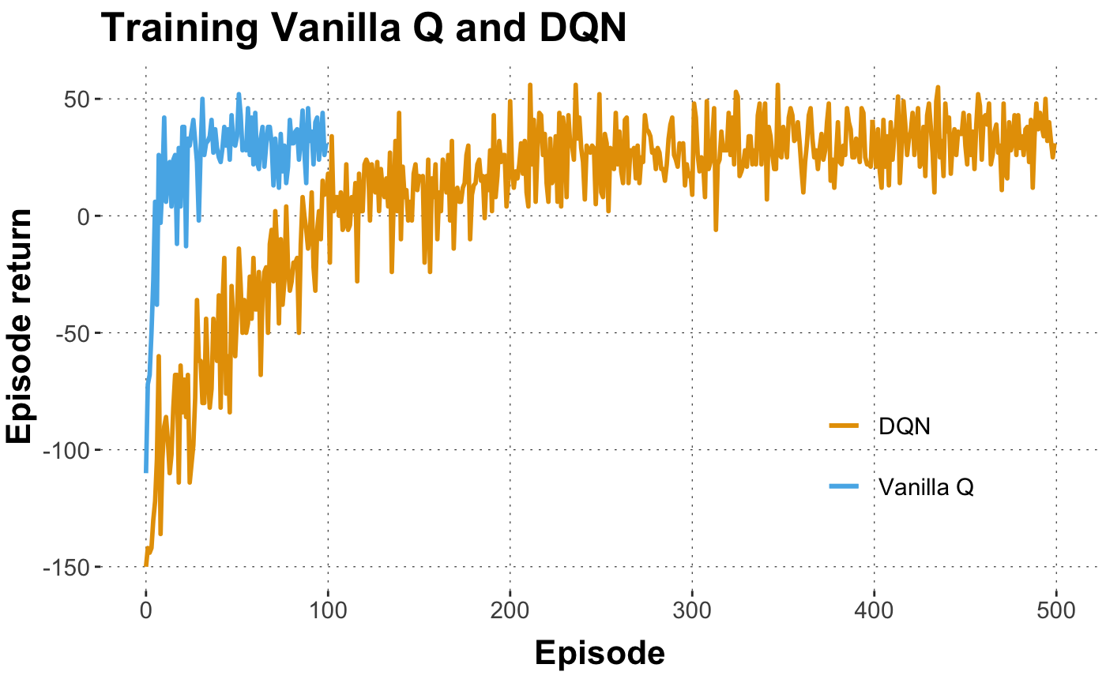
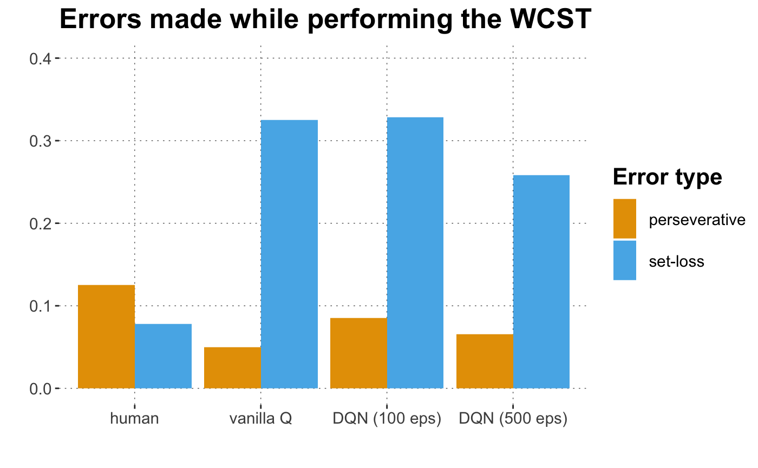
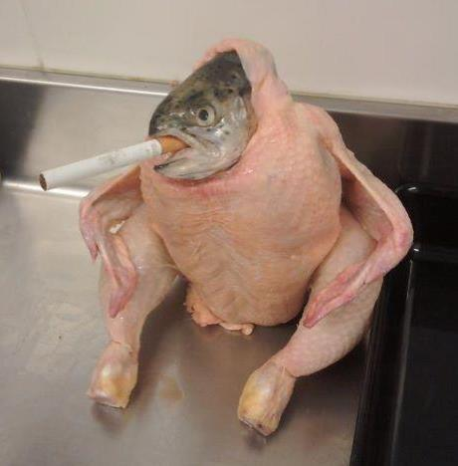

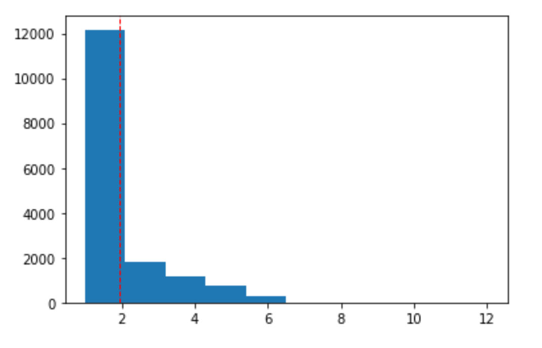
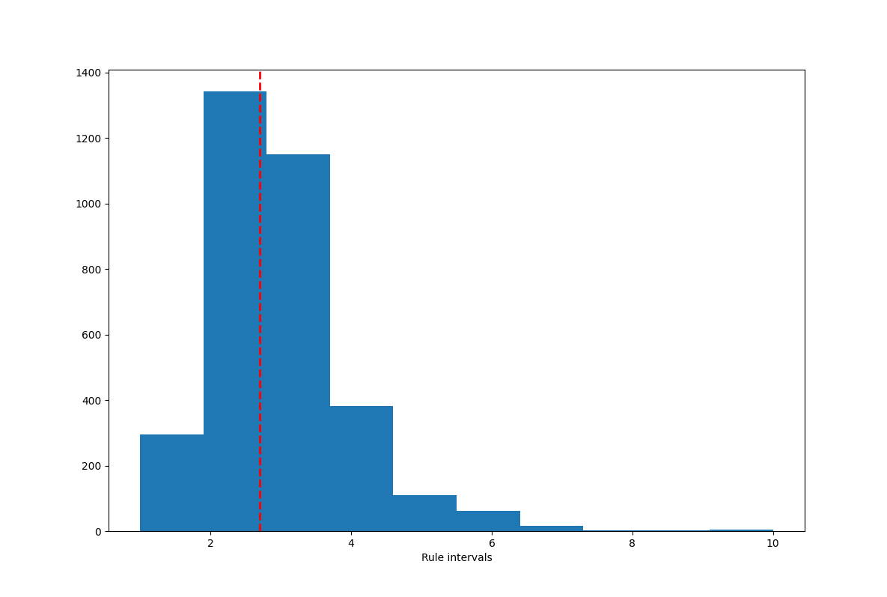
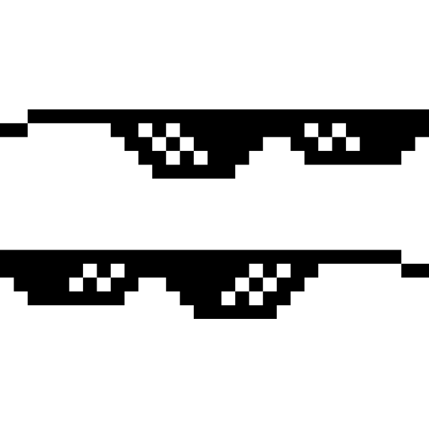
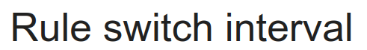
Results / Findings
Comparison among models
Distribution of Rule-switch intervals
- Human participants
(Steinke et al, 2020)
Distribution of Rule-switch intervals
- Deep Q
Human vs. Model performance
Mean
True mean
Mean
True mean
Notes:
Did the modeling work? Kinda
Key outcomes of your model evaluation.
During the final week of NMA, we intend to implement a deep Q-network to test if its performance is a better match to human data than the look-up table-based Q-learning implementation. <— Results from this

Slide 6
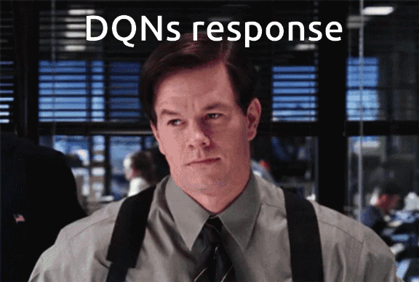
Discussion
What we can conclude
Models switched their sorting rule more frequently than humans
Models minimized perseverative errors at the cost of set-loss errors. After training for longer, DQN made fewer set-loss errors
None of the models had a similar error distribution to humans
Limitations & future directions
Policy-based methods - Policy gradient
Models designed for short-term memory - LSTM, GRU, LSTM-DQN
Model-based methods, direct modelling of rule switch probability - HMM
Maybe it is a low dimensional problem - and we don’t require a deep net at all?

Slide 7
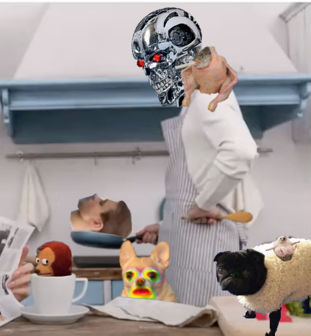
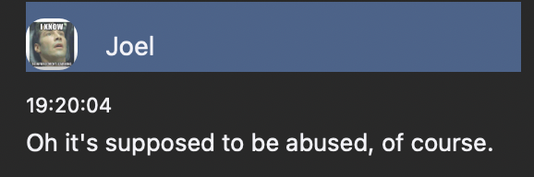
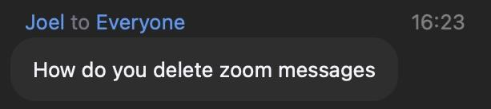

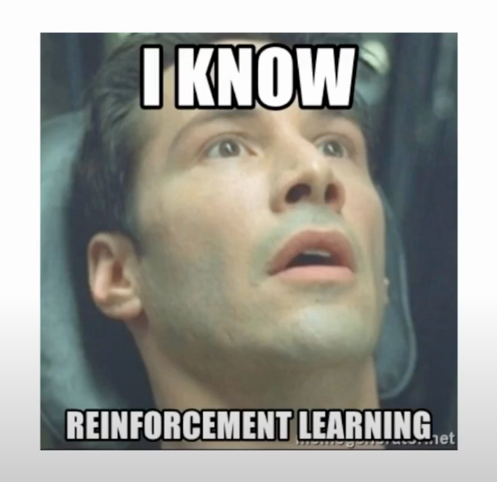
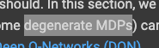
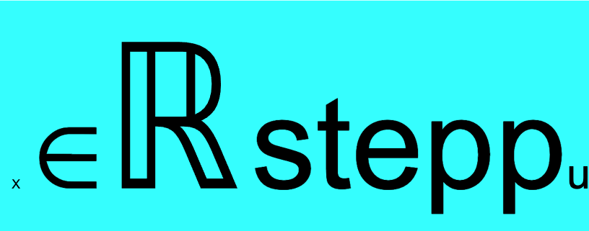
Refefefefefererencecees
DO WE NEED AN EPILEPSY WARNING BEFORE THIS SLIDE??
“Let’s sort
cards?”
DO WE WANNA DO LUNCH? or any time now:P XD
Check out our scripts at: https://tinyurl.com/ebonyfoxes
👍
Thumbs Up Sign Emoji - Emojipedia." https://emojipedia.org/thumbs-up/. Accessed 16 Aug. 2021.
TOP 10 Q-LEARNING MODELS DEEPMIND DOESN'T WANT YOU TO KNOW ABOUT!!!
“Can we change the x in step size to a Real number” — Natalia
Humans are just...
Kiitos ihan vitusti
ধন্যবাদ..
“ Fitting will fit great here feat Foxy Reinforcers 🥵🦊 “ - Thank you!
Mercy Bouquet!!

Slide 8
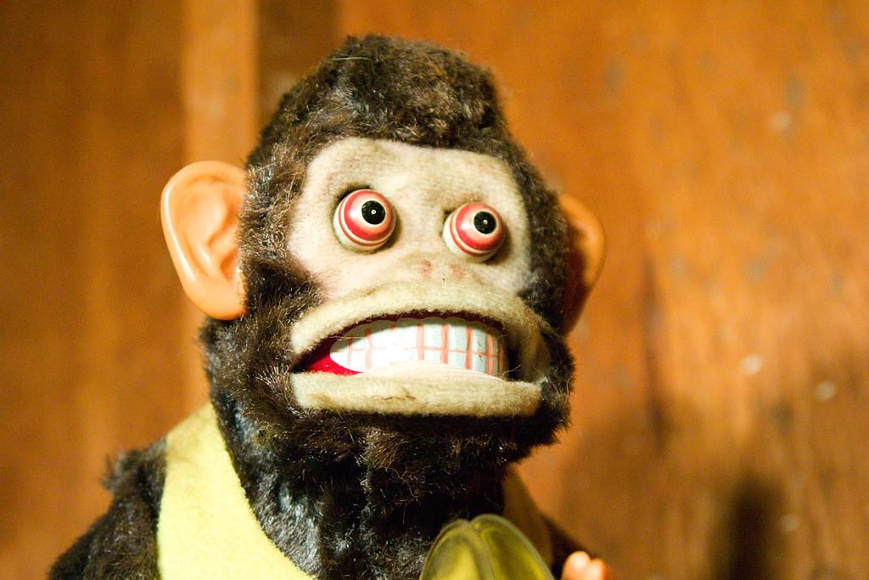

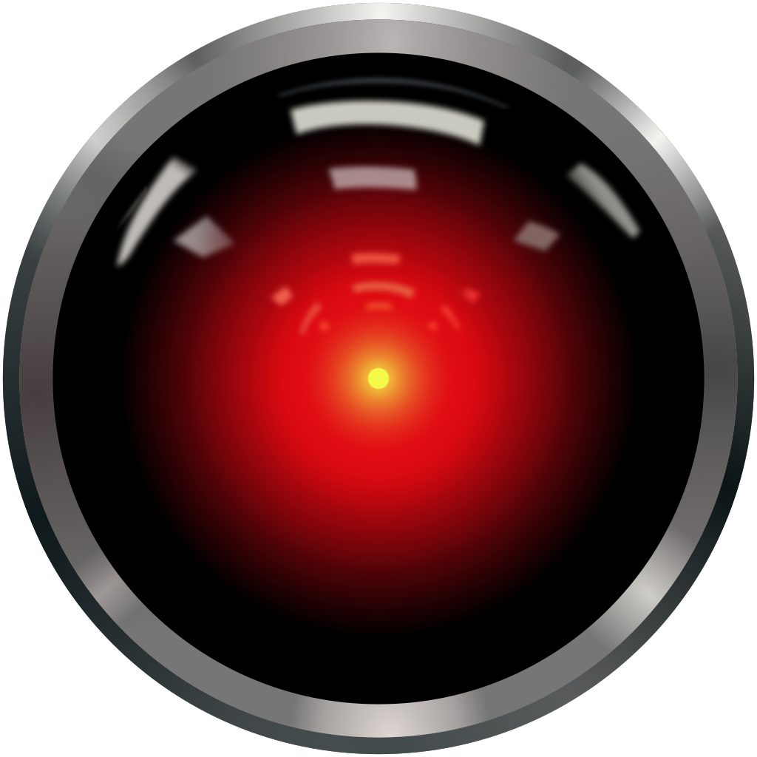
Thanks to Sanjukta, Hanifa.
Thanks to Radhimas, Jin and Michael.
And big thanks to Neuromatch!
Who we are (where, when, and why we are)
Joel Vasama
@Joku_joel
Ahmed Abdelsatar
@ah_abdelsatar
RL
Anindita Basu
@a7dita
Markus Karlsson
@neuro_mk
Natalia Scharfenberg
@schrfb

